Slide 1
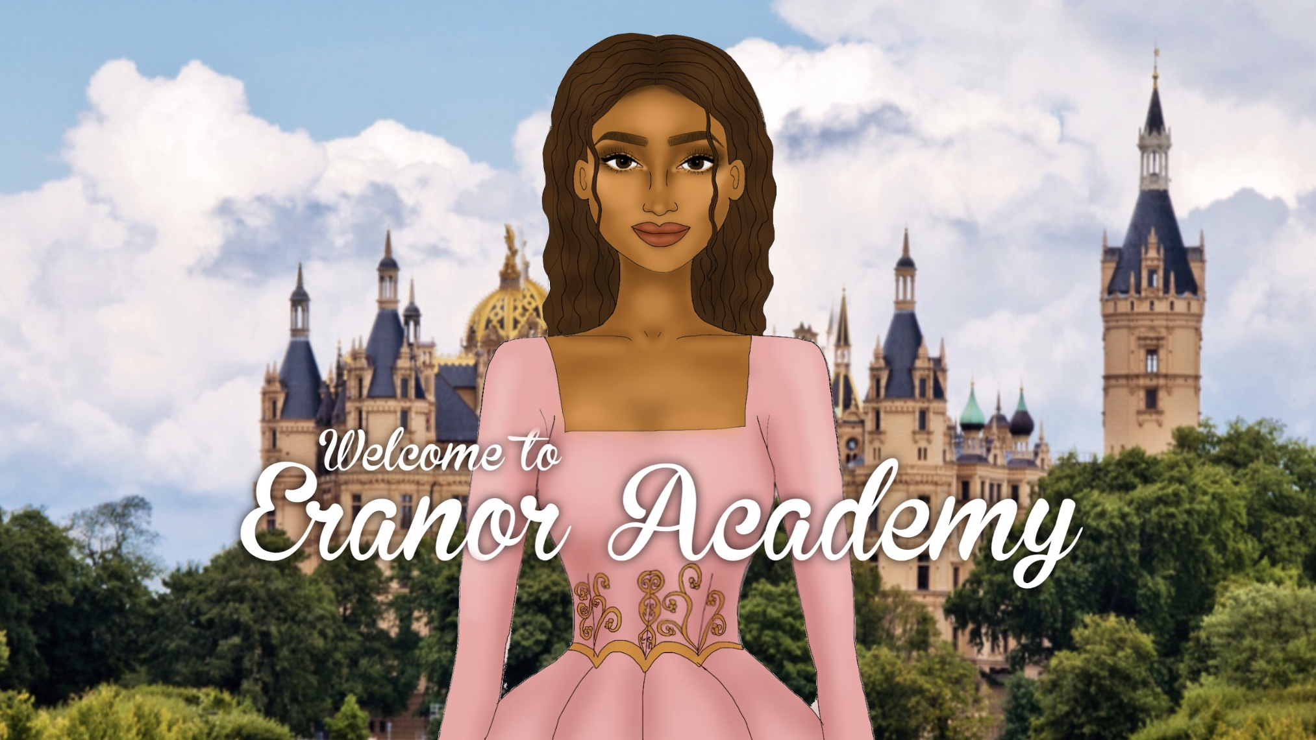
TAP TO START

Slide 2
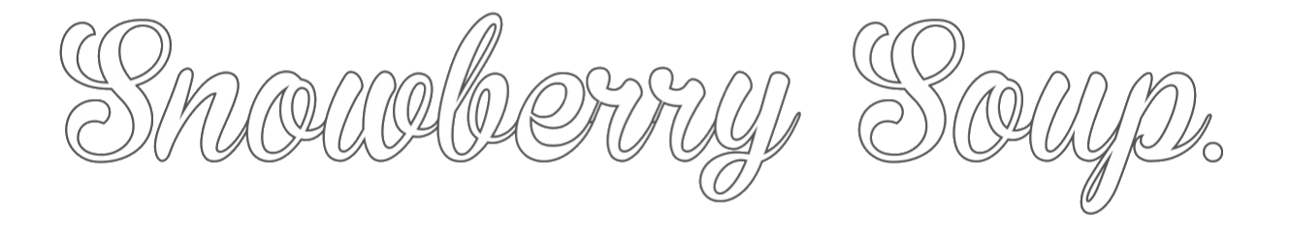
Chapter Two:

Slide 3
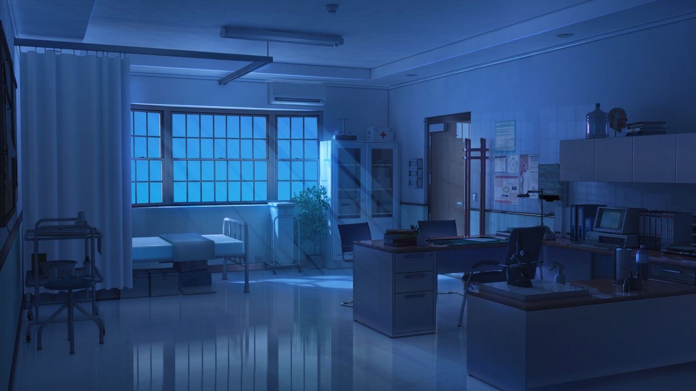
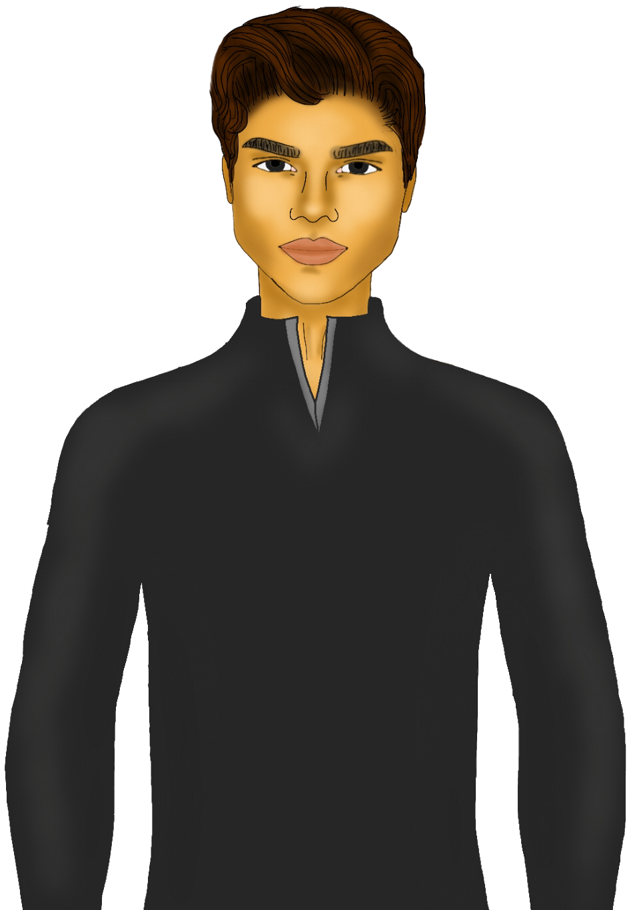
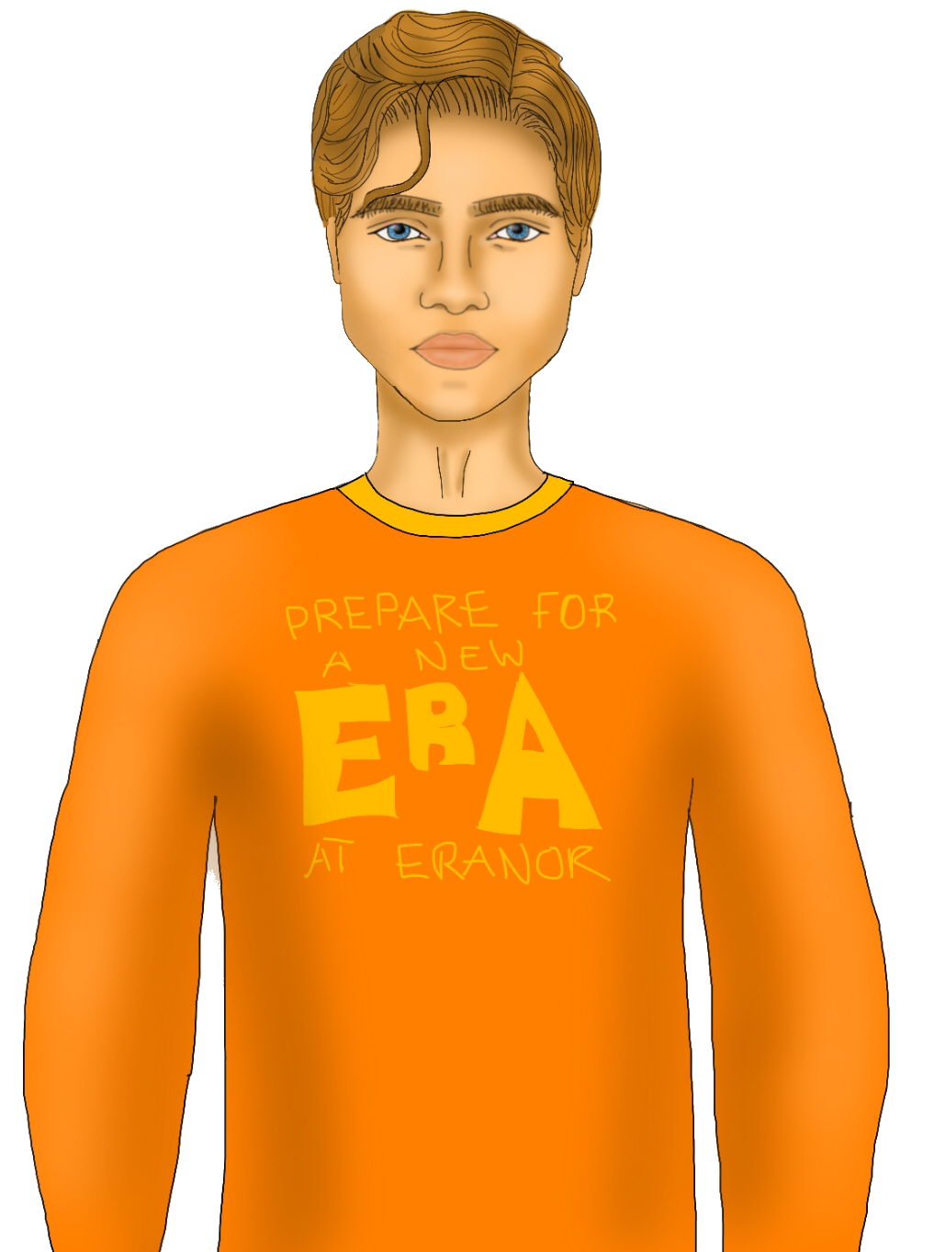
Mete and Romeo look at each other, before turning to the curtains which was slightly swaying. There was no wind. The windows were shut securely. Mouthing a count of three, they both charge towards the curtains and slide it open to see that someone was lying on the bed, figure completely hidden underneath the covers.

Slide 4
Mete went to open the covers, but flinched as the mysterious figure snored. “Mum... Mummy.” They whispered slowly. “Can you make some more snowberry soup...”

Slide 5
“Seems like they are fast asleep.” Romeo whispered to Mete. “I doubt they heard anything but their mummy.”
Mete smirked and nodded. “Yeah. Let’s go.”

Slide 6
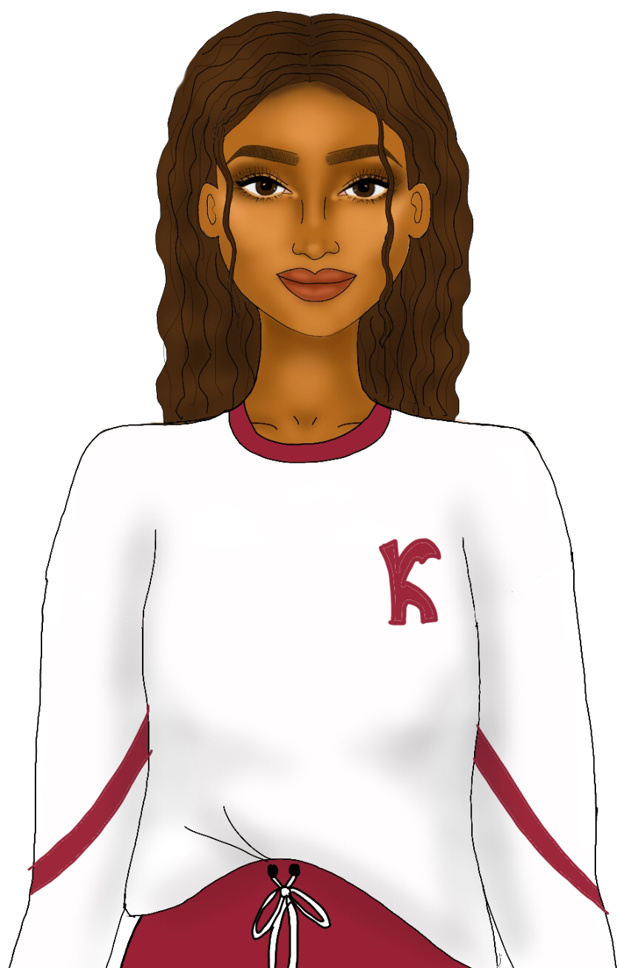
Nova heard their footsteps leave the room, and as soon as the door shut, she threw off the covers and breathed heavily. Thank goodness they fell for that! Nova quickly jumped out of the bed and sprinted back to her room. It took her a couple of wrong turns of course, but eventually she had made it.

Slide 7
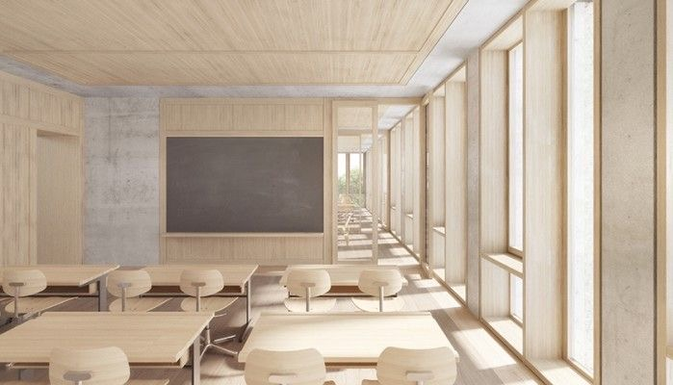
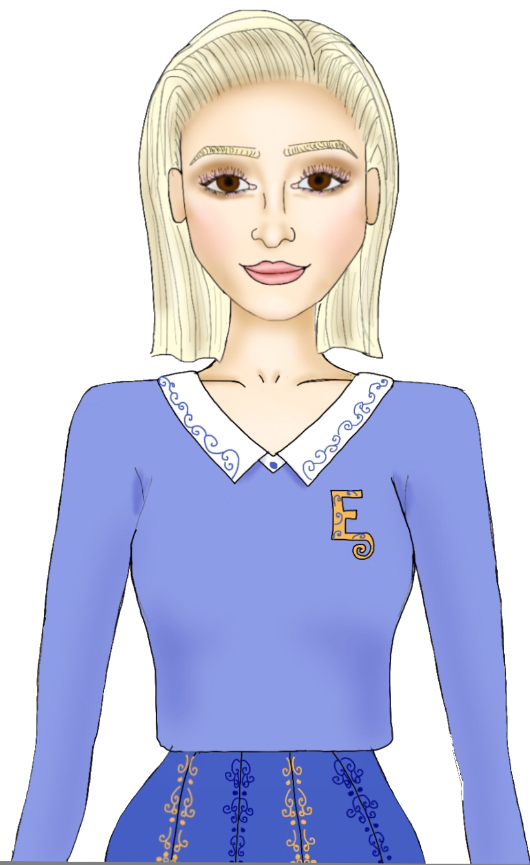
“What do you mean you lost the ring?!” Lira shrieked. “Oh Nova, you poor thing!”

Slide 8
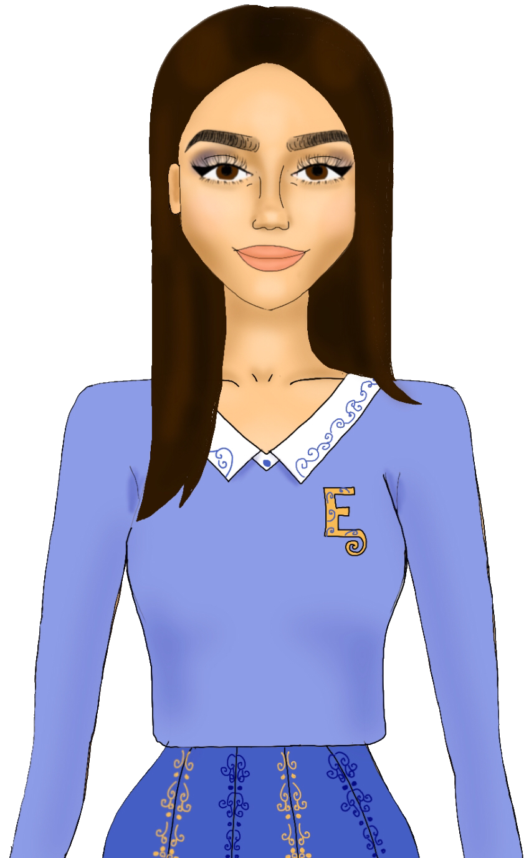
“Your great grandma’s going to kill you.” Sienna smiled her signature smile, patting Nova’s shoulder as if she was congratulating her. “Oh man, I love horror movies.”

Slide 9
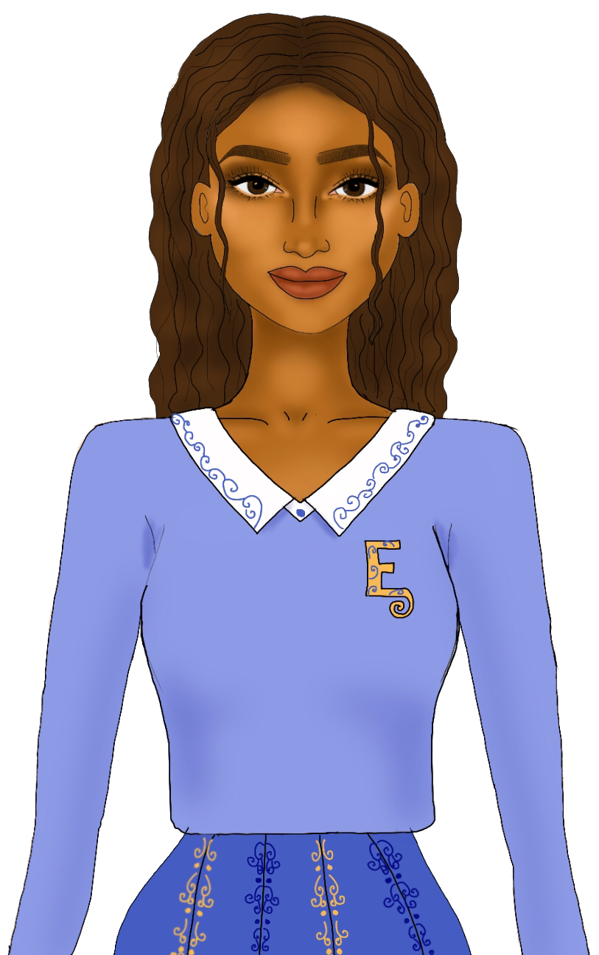
“Thank you for your empathy Sienna.” Nova replied sarcastically. “Real appreciated.”

Slide 10
“Trust me, that’s her showing empathy.” Lira shook her head as Sienna dazed off, most likely thinking about how the horror movie will roll out.

Slide 11
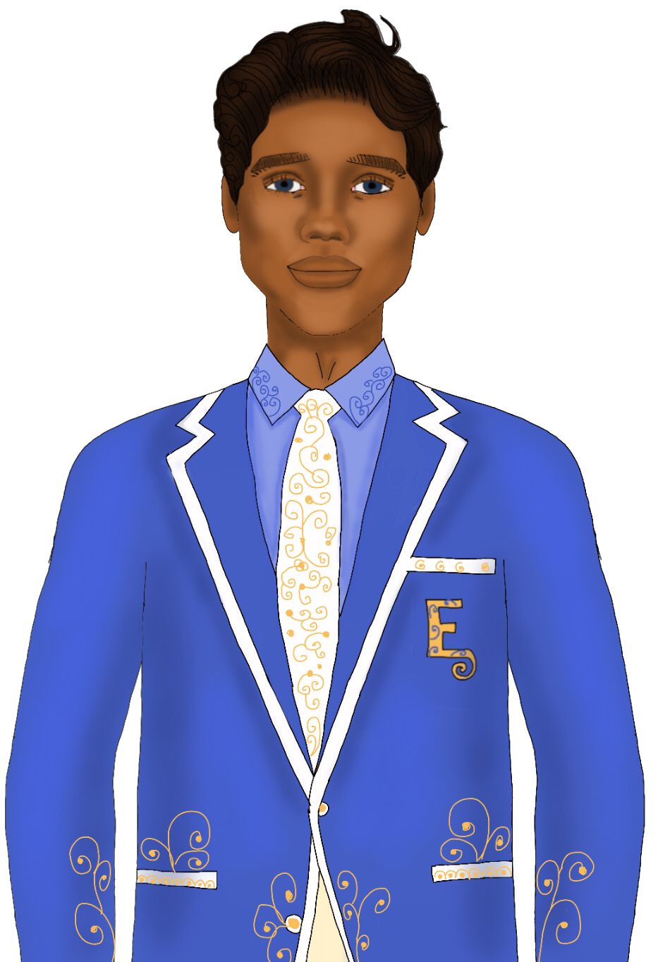
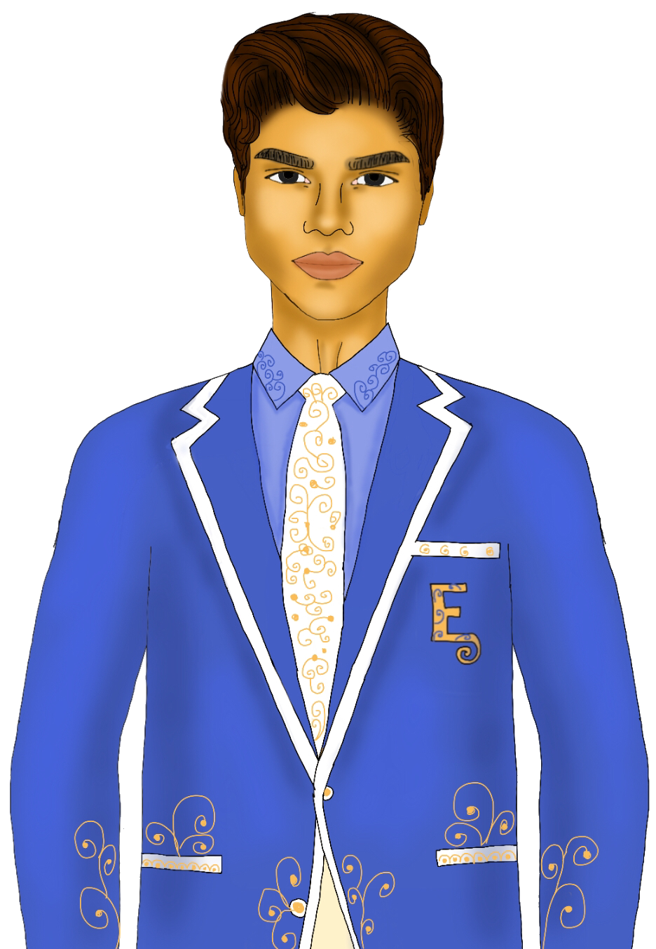
Nova opened her mouth to reply but her voice-box was immediately ceased by the entrance of the mighty ex-crown prince, André and his even mightier companion, the prince-who-is-not-actually-a-prince, Mete Bashir.

Slide 12
Nova gulped as she remembered Mete’s words.
“We gotta stay close to her.”

Slide 13
She looked behind her and found that there was an empty desk perfectly convenient for Mete’s mission. “Splendid.” She muttered under her breath.

Slide 14
“Let’s sit over there.” As expected, Mete suggested to André who shrugged in response. Nova tried to remain as collected as possible as they took their seats behind her and Lira.

Slide 15
“That’s weird. They usually sit at the back.” Lira whispered to Nova. She looked over to Sienna who was sitting on the left of Nova, whom eyed them like a predator eyeing their prey. Dang. Nova thought.

Slide 16
“If I were those boys, I would scream like a little girl and run out of the room.” Nova said quietly to herself. Lira — thinking that she was talking to her — giggled.

Slide 17
Nova could practically feel Mete’s eyes staring the back of her head down. And she wasn’t the only one who noticed. Sienna’s eyes travelled between Mete and Nova warily.

Slide 18
“So how are we going to find the ring when it’s basically invisible?” Lira furrowed her brows in concern.

Slide 19
“I don’t know.” Nova sighed. “Last time I saw it was when we were in the cafeteria yesterday. After that, I have no idea.” Behind her, André shuffled in his seat. Their voices were low, but Nova knew that both of them could hear her.

Slide 20
“Well, let’s go and check in the cafeteria after class. Maybe Sienna can help us too, she’s got really good eyes. Right Sienna?”

Slide 21
Sienna didn’t reply, as she was too busy eyeing down Mr Bashir. Then, she did what Nova hoped not to happen.
“Is there a problem with the back of Princess Nova’s head, Prince Mete?” She blurted out.

Slide 22
Nova closed her eyes, an expression of pain on her face. “Why, Sienna, why?” She mouthed to her. Slowly, she peered over her shoulder to look at Mete, whom seemed to be taken back by Sienna’s outburst.

Slide 23
Mete swallowed, having no idea what to say. What could he even say? “Yes because I am a Key and ‘they’ are after her”? Sienna had put him in an awkward position.

Slide 24
“Princess Nova?” André spoke.

Slide 25
Lira looked at Nova surprised, before Nova turned to André with a smile. “Prince André. How nice to see you.” She lied. She was not very fond of André, whom practically shamelessly death-glared her at her father’s coronation.

Slide 26
“You too.” He simply replied.

Slide 27
Nova looked at Mete, whom was leaning back on his seat, arms crossed over his chest as he watched her. He seemed to really like that posture. Just as he was about to say something, Nova quickly twisted back to normal position, leaving him hanging. Luckily, the professor walked in just in time.

Slide 28
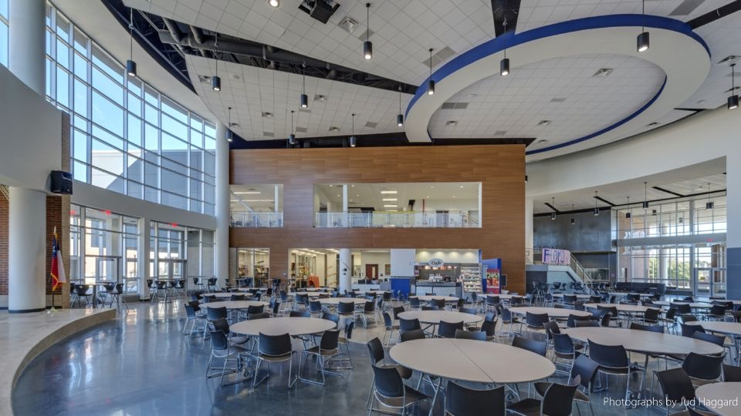
“I cannot believe prince André talked to you! He never talks to anyone apart from Mete and Romeo — not even his cousins!”

Slide 29
“It’s not that big of a deal. He only said like four words.” Nova shrugged as she continued to search the cafeteria grounds. For some reason, Mete’s lack of words were more of a big deal to her as she could barely get the non-prince out of her mind.

Slide 30
“Uh, the fact that he even said one word...” Sienna spoke from under the fifteenth table she was searching. Finally she crawled out with a disappointed sigh. “Sorry buddy, but the ring is not here. It’s most likely that someone took it. I mean I would take it. And sell it for millions in the black market.”

Slide 31
Lira shook her head disapprovingly at her sister, whilst Nova was on the brink of tears again. “I’m going to go to the restrooms. I’ll be back.” She twirled on her heels and rushed out of the cafeteria before anyone could spot her tears.

Slide 32
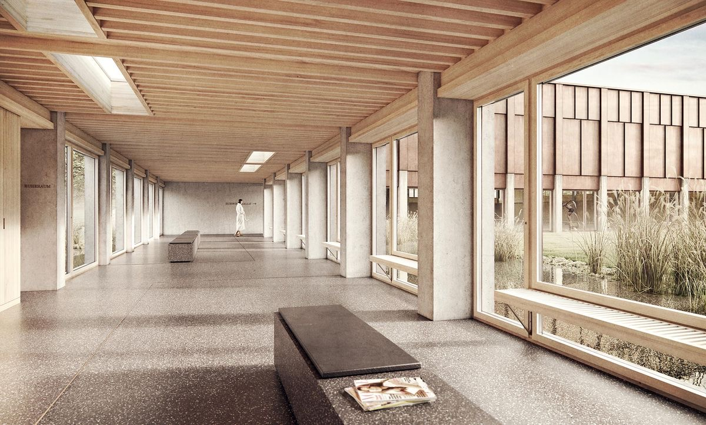
Nova rushed through the hallway. As she did so, she noticed Prishta speaking to André who did not seem to give a damn about what she was saying. True enough, her mouth was running a word marathon and his said absolutely nothing in return. As she crossed paths with them, André’s eyes followed her.

Slide 33
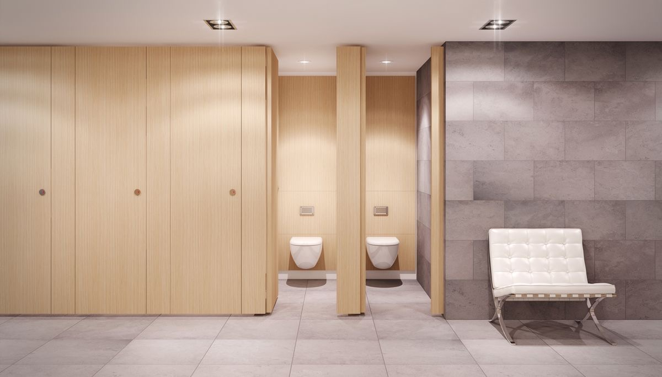
Nova dashed into a cubicle and shut the door. She was very disappointed in herself. It hadn’t even been a month yet since she’s been a princess, and she’s already let her country down. Her great-grandmother had entrusted her with a sacred Khiarian monument, and she loses it just like that.

Slide 34
“How am I going to face my great grandmother now?” She squirm at the thought of the deadly look on her face when she’d find out. She gulped. “Sienna’s right. My life has turned into a horror movie!”

Slide 35
Nova inhaled deeply before exiting the cubicle. She decided to walk around for a while before she returned to the cafeteria.

Slide 36
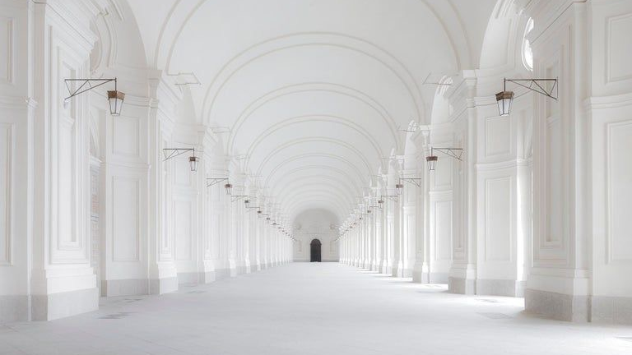
Nova exited the opposite end, towards the east wing. The east wing’s interior design was more classical than the modern west ring, which was where majority of school took place. The hallway was magnificent, a breath of fresh air which was exactly what Nova needed.

Slide 37
She didn’t noticed that she had walked passed someone until they cleared their throat and said, “Looking for this?”

Slide 38
André was standing there, leaning on the pure white wall with his hand extended, revealing a stunning red gem. Nova was too shocked to say anything. André didn’t mind, as he took her hand and slid the ring onto her finger. Then, he smiled slightly as he said, “Now you’ll be able to face your grandmother again.”

Slide 39
Nova’s cheeks burned as she realised André had heard her talk to herself. He didn’t step inside the girl’s toilets, did he? Or perhaps he didn’t have to, Nova did have a tendency to talk to herself loudly sometimes.

Slide 40
“T-thank you,” Nova managed to say after some time of awkward silence. “Thank you so much.” Though to be honest, she did find it quite suspicious that he was being so kind. That death glare wasn’t exactly a forgettable one. Or perhaps it was just a misunderstanding? Perhaps at that moment when he was looking at her, he happened to have an irritating itch in his eye?

Slide 41
“Don’t mention it.” He replied, making no effort to release her hand. Hmm, maybe it really was a misunderstanding. He eyed the ring. “It’s made out of kalinium, right?”

Slide 42
“Yes, from the Kalinium cave.” Nova confirmed.

Slide 43
“Ah yes, the Khiarian sacred cave that lies just outside of Qarrah.” There was an unreadable expression on his face as he swallowed tightly.

Slide 44
Nova nodded, gently slipping her hands out of his.

Slide 45
“Sorry.” He murmured, not sounding very genuine.

Slide 46
“It’s okay.” Nova replied, not paying attention to it. She was more concerned about something else. “How did you find it?”

Slide 47
“He didn’t. I did.” Suddenly, Mete popped out of nowhere. He subtly glared at André, who remained expressionless. “I noticed you dropped it after you left the cafeteria yesterday.”

Slide 48
“Oh.” Nova blushed as she remembered how she had hastily left because of the way Mete was attentively looking at her. Then, she furrowed her brows. How could he have noticed I dropped it? He was sitting twenty metres away, plus the thing is half invisible! Wow. She thought. He must have remarkable eyesight.

Slide 49
“Yeah. Oh.” He teased her, a small smirk on his face.

Slide 50
“I-I mean thank you.” She blushed again. “Thank you Prince Mete for finding my ring, and thank you Prince André for returning it to me.”

Slide 51
“No worries, princess.” Mete replied smoothly. “But, for my favour, you will need to repay me.”

Slide 52
“R-repay you?” Nova stuttered, for good reason this time. “H-how so?”

Slide 53
Mete pretended to think about it for a few moments. Then, he shrugged. “We’ll see.”

Slide 54
Nova swallowed uneasily. “Uh, okay.”

Slide 55
“Well uh, don’t worry, you won’t need to owe me.” André awkwardly spoke. Oh yes, André was here. Nova had forgotten he was standing right here as well for a couple of moments.

Slide 56
All Nova could do was shyly nod. She could not stay here for a moment longer, otherwise her legs would start trembling. She had always been shy around new people, but never this shy in front of someone.

Slide 57
“I have to go now, my friends are waiting for me.” She spoke, walking passed the boys. “Thanks again, bye.”

Slide 58
“Bye.” Mete waved, shaking his head as the princess ran away from him once again. This is going to be tough. He thought, before turning to André. “Well, well, well,” He teased. “Did I just witness André Hamman talking to someone for more than ten seconds?”

Slide 59
“Shut up man.” André whacked his shoulder, as Mete roared with laughter. “I don’t know why. There’s something different about her.” He said as he watched Nova run down the hallway.

Slide 60
Mete tried to ignore the pang of an unusual feeling. He swallowed in an attempt to rid of it. Yeah. There is.

Slide 61
Lira stood up as she saw Nova approaching. “Nova, we’ve looked everywhere for you—“

Slide 62
“—You found it!” Sienna exclaimed with the most excitement anyone had ever seen on her. After she realised what she had done, she cleared her throat and shrugged. “Good for you I guess.”

Slide 63
“How did you find it?!” Lira beamed.

Slide 64
“Well, erm I didn’t.” Nova gave them a tight lipped smile before breaking the news. “André gave it to me. And technically, Mete found it.”

Slide 65
Lira remained silent.

Slide 66
Sienna was also silent. But not for long.
“Wait—wait—wait, so you’re telling me, two-thirds of the princes of Antarctica personally handed you back your ring?!”

Slide 67
Nova nodded.

Slide 68
“Who are you, Nova?” Lira whispered scarcely. She looked a little faint. “Who are you?”

Slide 69
“They seemed quite nice.” Nova said, taking out her lunch. It was her favourite: snowberry soup. “Well, except for the fact that I now owe Mete.”

Slide 70
Sienna scoffed. “Mete Bashir. There’s something really off about him...”

Slide 71
“Wow.” Nova muttered. “Her senses are on point.”

Slide 72
“What?”

Slide 73
“Nothing.”

Slide 74
“But Nova, promise me you won’t get on their bad side!” Lira cried, her face overfilled with concern. “Last time someone got on their bad side, they never came to Eranor again.”

Slide 75
Nova swallowed, nodding. “I promise.”

Slide 76
“That means you’ll have to do what Mete asks of you.” Sienna grinned. “If it’s gruesome, can you send a picture to me?”

Slide 77
Lira pressed her lips together and closed her eyes momentarily. “Nova, I apologise deeply for my twin sister. I wish we were able to control each other’s bodies, then I would press her lips together for as long as I live.”

Slide 78
Sienna grunted. “And I would control your hand to punch you in the face for as long as I live— Hey Nova what’s that?”

Slide 79
Nova smiled. “It’s snowberry soup. In Khiara we call it ‘Mahkta’. Want to try some?”

Slide 80
“I would love to.” Before Nova could pass it to Sienna, she already had it in front of her and was taking a sip. “Wow, that is delicious.”

Slide 81
“Right?! Lira would you like to try some?”

Slide 82
“I’m okay thank you.” Lira smiled. Then, the smell hit her nose. “... But it smells so good! Can I?”

Slide 83
“Of course.” Nova watched as they tried the soup then smiled with pure bliss, making her feel like the effort she had put in making the soup was worth it. Her mind wandered to when she had mentioned it in her ‘sleep talk’ at the nurse’s office, when Mete and Romeo had their interesting discussion.

Slide 84
Was there really someone after her? And by being after her, they were after her country? If it was true, Nova could not just sit around and drink snowberry soup. No, she must catch ‘they’. Well, first she must find out who ‘they’ are. Then she has to defeat them!

Slide 85
But Nova knew she could not do it all by herself. She contemplated telling Lira and Sienna about it, but she knew by telling them, she would be putting them in danger. Then there was only one other option: team up with Mete and Romeo.

Slide 86
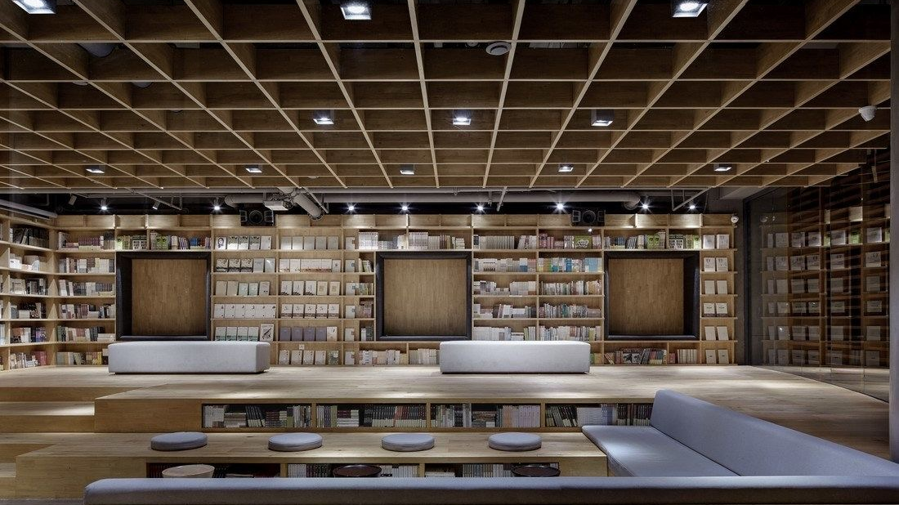
After the school day, Nova, Lira and Sienna decided to have a study date at Eranor’s library. Since Nova was new, the plan was that Lira and Sienna would help her catch up. However, they became a little distracted.

Slide 87
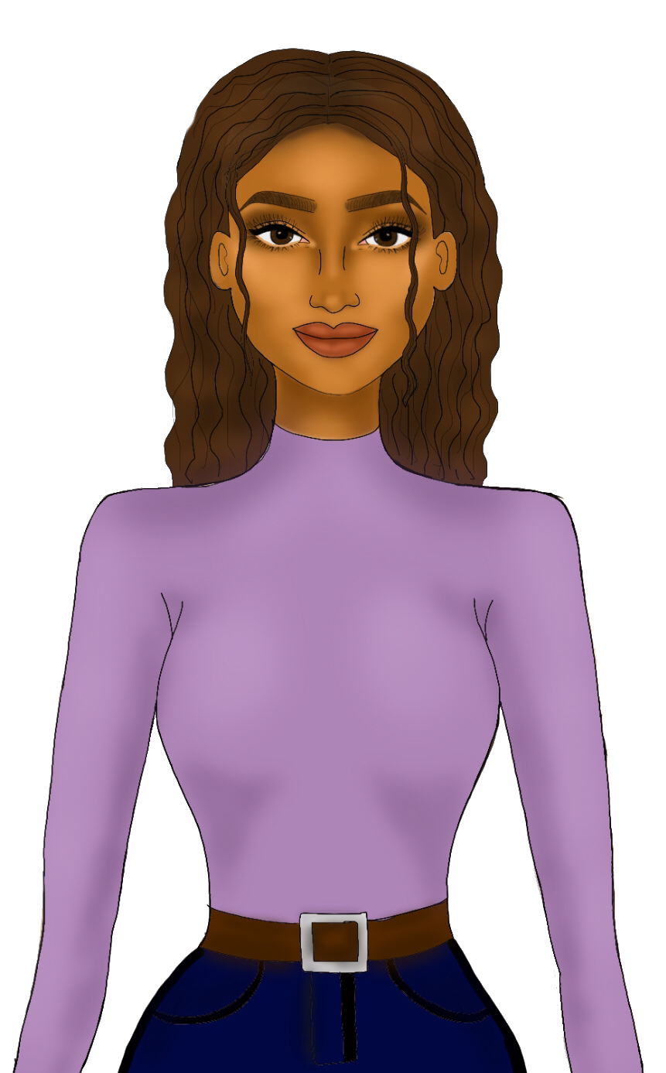
“Moonshine ball?!” Nova enquired.

Slide 88
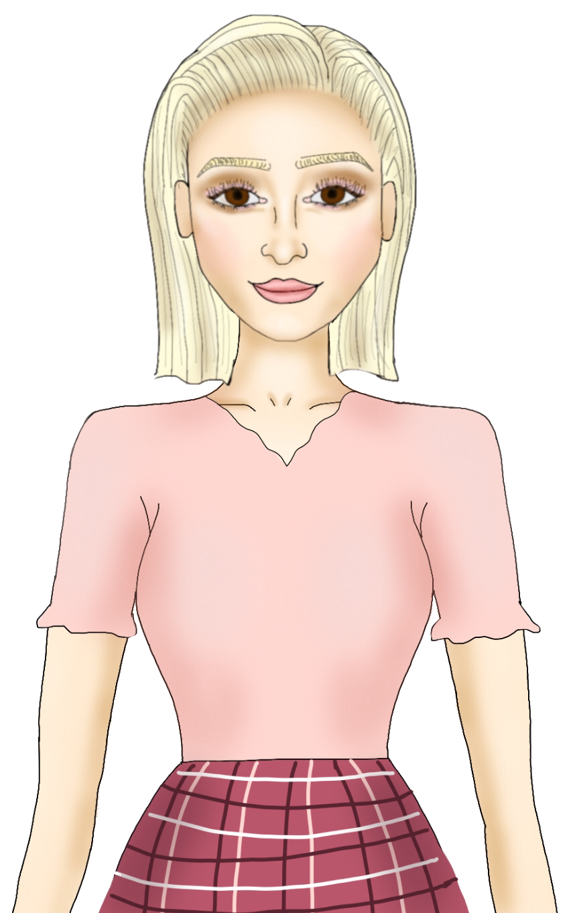
“Oh yes. It is one magnificent ball, my favourite time of the year!” Lira squealed.

Slide 89
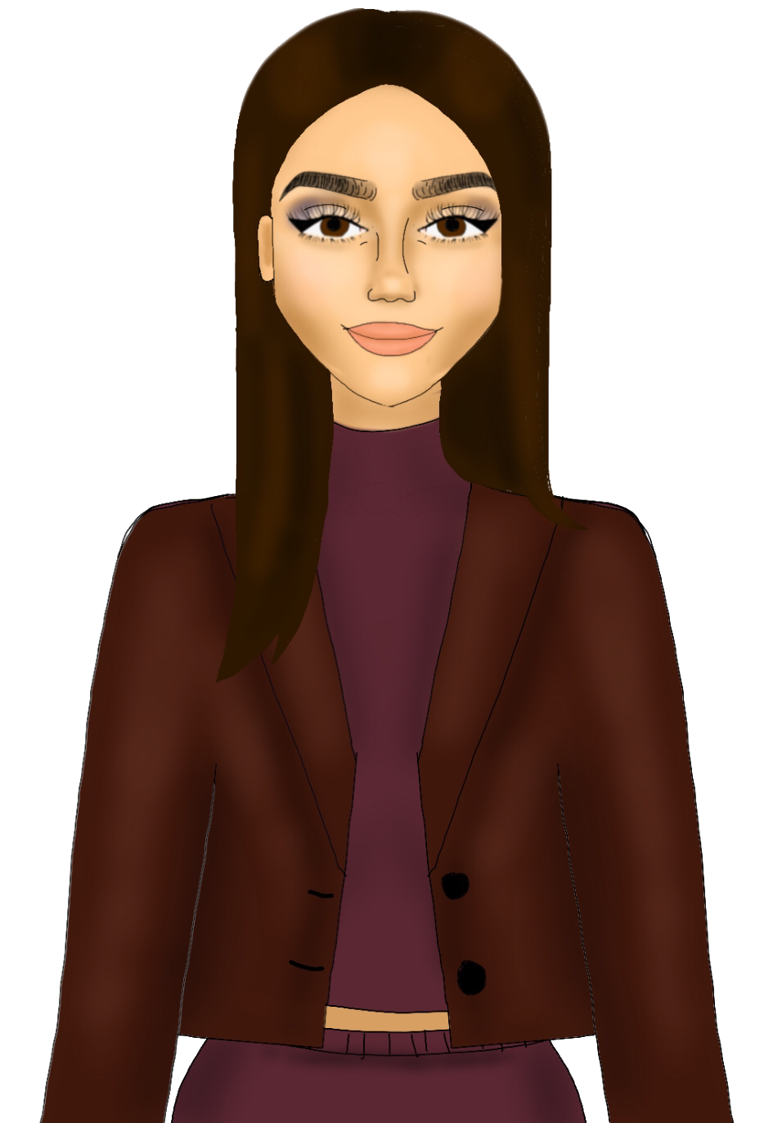
“It’s Ivanian family tradition. On the first full moon of the year, we hold a gorgeous masquerade ball that is completely night themed, in honour of the first king of Ivan—“

Slide 90
“Who is our great, great, great, great, great—“

Slide 91
“—Yeah we get it; Our ancestor, who defeated the invaders and took back our land in just one night.”

Slide 92
“That’s incredible!”

Slide 93
“Right?! You should see the ball Nova, it’s mesmerising! The entire ceiling replicates the night sky and the stars and the galaxies — its a visionary.”

Slide 94
“You will get to see it, actually. Every year, Headmistress Georgette chooses five events from randomly chosen countries to be held right here in Eranor. And the Moonshine ball is one of the chosen events this year.”

Slide 95
“The first full moon of this year is coming very soon as well.” Lira grinned. “Its only two weeks away!”

Slide 96
“Fantastic!” Nova beamed. She always wanted to attend a royal ball, an event she thought she would only ever attend in her daydreams. “I can’t wait!”

Slide 97
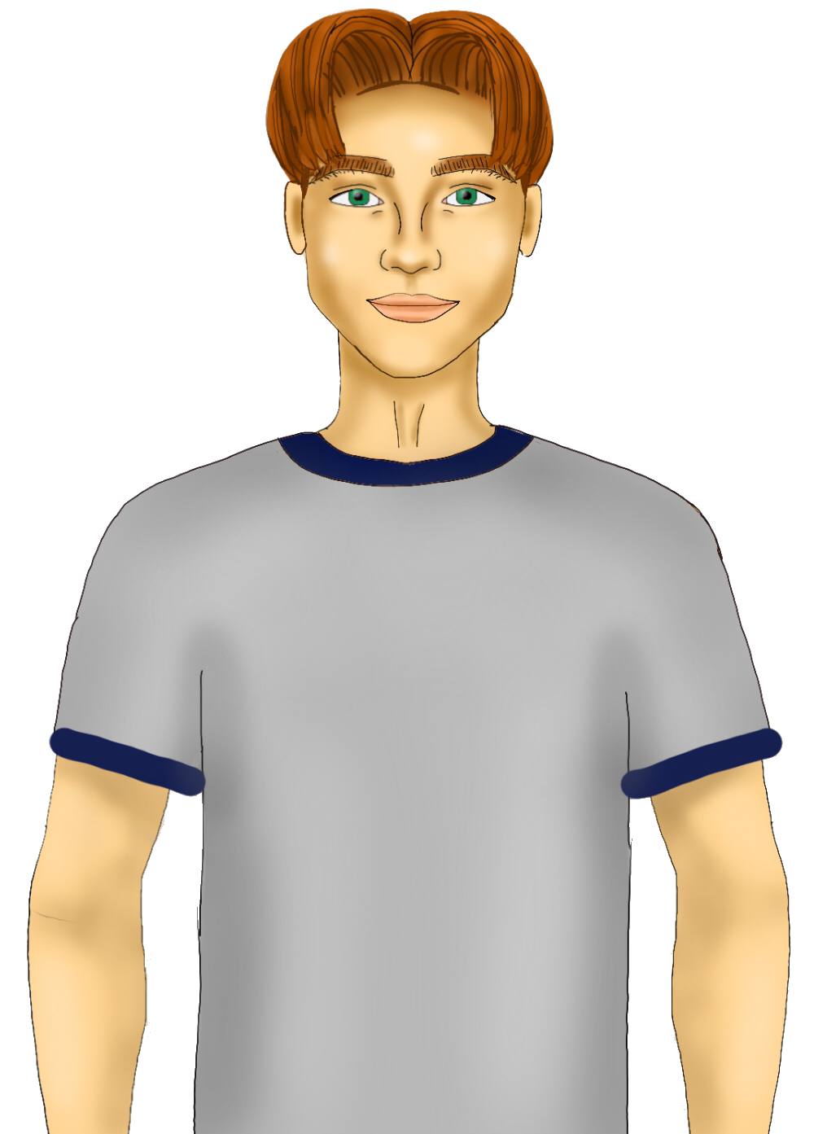
All three fell silent when, out of nowhere, Guze Kireman entered the scene.

Slide 98
He did not even acknowledge the three as he surveyed the books on the shelves with intense concentration. “F1659, F159...”

Slide 99
Sienna looked down at the stack of books left on the table beside her. One had ‘F1659’ clearly written on it.

Slide 100
“Are you going to use that?”

Slide 101
“Please, do I look like a textbook — or any kind of book — reader to you?”

Slide 102
“Give it to him!” Lira hissed, her eyes shining with excitement. “This is your chance!”

Slide 103
Sienna’s face began to turn red. Nova had to rub her eyes. Was she seeing right? Sienna — blushing?! “N-no way.” Sienna stammered. Lira and Nova gasped. Sienna — stuttering?!

Slide 104
“I never thought I’d live to see the day my twin sister stutters.” Lira whispered, mouth open in awe.

Slide 105
“Me too.” Nova agreed, her face mirroring Lira.

Slide 106
“Shut up, you two.” She snapped. She tore off a piece of paper from her notebook, scribbled something on it and slipped it inside the book. As Guze’s back was facing her, she tip-toed to the bookshelves and slid the book in there. Then, she walked back and nudged Nova.

Slide 107
Nova, getting the hint, cleared her throat. “Er, excuse me.”

Slide 108
Instantly, his eyes turned to their table. “Ah, good evening your majesties.” He winked. “Sorry I didn’t see you ladies. Princess Lira, Princess Sienna...” Lira returned the greeting enthusiastically, whereas Sienna nodded in acknowledgement, her cheeks still burning red. “And new princess.”

Slide 109
“I’m Nova.” Nova smiled, extending her hand. “Nice to meet you.”

Slide 110
Guze smiled charmingly, taking her hand and placing a kiss on it. That took Nova by surprise. “Hello Princess Nova, I’m Guze.”

Slide 111
“I know,” She laughed nervously, not daring to look at Sienna. “You are very famous in Khiara.”

Slide 112
“Really? I’m honoured.” Guze grinned. He had the most perfect smile. If someone were to do some geometric calculations, Nova would not be surprised if his smile was completely symmetrical.

Slide 113
“Erm, apologies for bothering you ladies,” Guze rubbed the back of his neck nervously. “Do you happen to know where I can find book F1659?”

Slide 114
“Of course we can help you!” Lira exclaimed cheerfully. She was literally a ball of sunshine. “You can find it over there.” She pointed at where Sienna had slipped the book, and when he turned, she winked at Sienna.

Slide 115
“Sweet. Thanks so much.” He grinned, pulling out the book. “Have a good evening, your highnesses.”

Slide 116
“You too.”

Slide 117
“Bye!”

Slide 118
As soon as he left, Sienna exhaled strongly, as if she had been underwater the entire time. “Oh man, that was the best moment of my life.”

Slide 119
“Uh, you didn’t even say anything.” Lira pointed out, furrowing her brows.

Slide 120
Sienna waved her off before turning to Nova with a pant-peeing glare. “You. You just have to be so beautiful and charming, don’t you?” She grumbled to herself as she packed up her things and walked off.

Slide 121
Nova gulped. “I think that was a compliment, but it sounded so insulting.”

Slide 122
“Yeah, that’s my sister for you. Don’t take it personally, she’s always like that.” Lira shrugged as she packed her things as well. “It’s almost 8, so we gotta leave now. C’mon, lets go!”

Slide 123
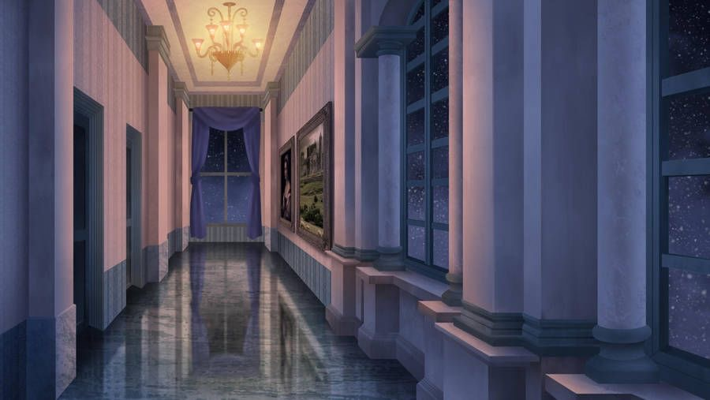
After bidding Lira goodbye, Nova was on her way to her suite. She shivered uncontrollably. For some reason, the hallways felt eerie tonight. Perhaps it was because she now knew that someone was after her. They. As she walked, her breathing pace increased.

Slide 124
Then, what she feared had occurred. Out of nowhere, a dark figure had grabbed her from behind and a handkerchief covered her mouth, dragging her into darkness.

Slide 125
End of Chapter
Let us know what you think! Tweet, instagram or facebook us with the hashtag #eranoracademy or tag us @eranoracademy
Thanks for Reading! 😁

